Slide 1
Geometric Motion Planning:
Finding Intersections

Slide 2
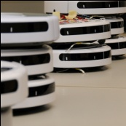

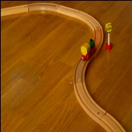
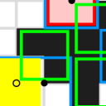
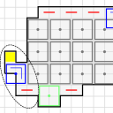

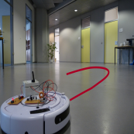

Motivation – Finding Intersections
One-Dimensional Agents
  No simultaneous movement
  Simultaneous movement
Two-Dimensional Agents
Outlook
MichaelEClarke
@flickr

Slide 3
Motivation

Slide 4
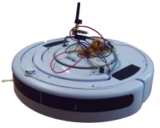

Motivation
planning motions for mobile agents:
  motion primitives
  sensors
  communication
here: agents perform geometric primitives
  move to another agent
  move on ray between two other agents
  move on a circle
what can we achieve with this model?
intersection point of trajectories of two agents

Slide 5
Finding Intersections
two curves C₁ and C₂
two agents A₁ and A₂
agent‘s minimum travel distance is its diameter
➔ discrete search space:
integer grid
A₁
C₁
C₂
A₂

Slide 6
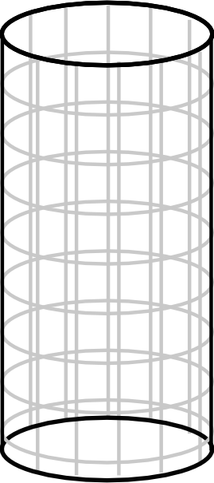
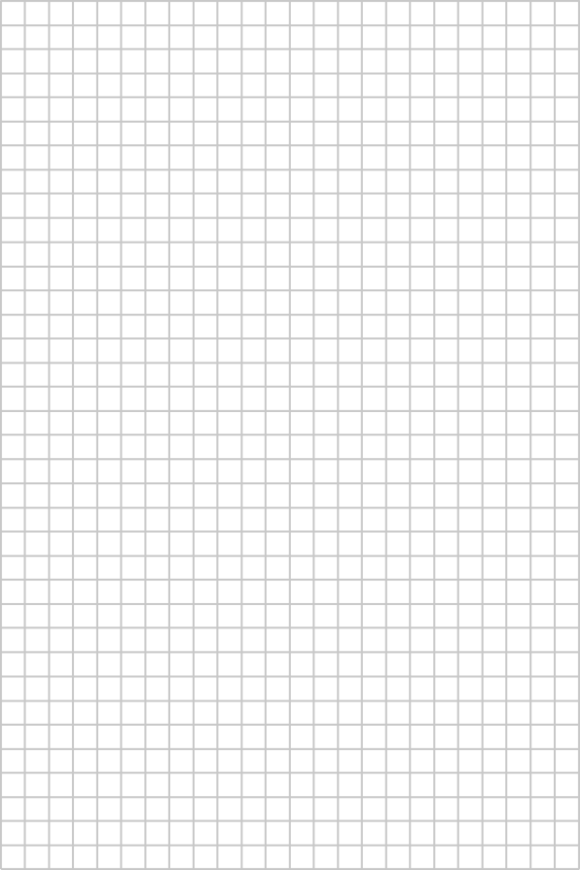
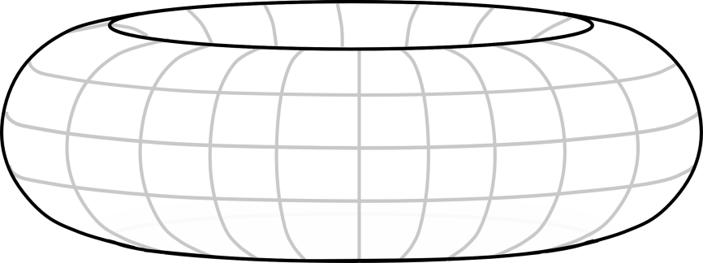
Finding Intersections – Search Space
Bilder – fälle grid und einbettung
One open, one closed curve:
Two closed curves:
Intersection point=suche

Slide 7
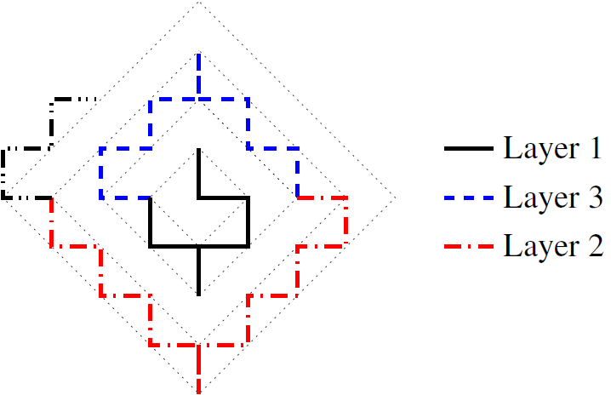
Finding intersections
searching on an infinite integer grid was considered by Baeza-Yates et al. (1993):
  any online strategy for finding a point within distance at most k (in L₁-metric) needs at least 2k²+O(k) steps
  strategy NSESWSNWN:
    visits points on diamond around origin in distance k
    requires 2k²+5k+2 steps
Markiere diamonds, und 4k+3 für schicht k
only 4k+3

Slide 8
Search Competitivity
searching in the plane is not constant competitive
search competitivity as quality measure (Fleischer et al. 2008)
  We compare the path of the online search strategy
    NOT to the shortest path
    but to the best possible online search path
  search ratio sr:
  goal: sr(ALG) ≤ c∙sr(OPT)+a
  ≤ constant ➔ ALG search competitive
Folie zu serach comp.?
|Π(p)|
online strategy‘s path to p
sup_{pG}
|sp(p)|
shortest path to p
environment
ALG
OPT

Slide 9
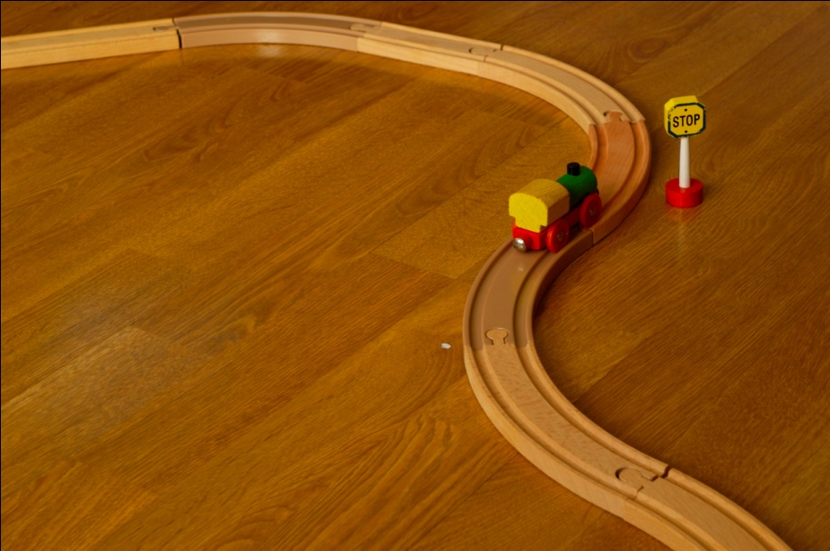
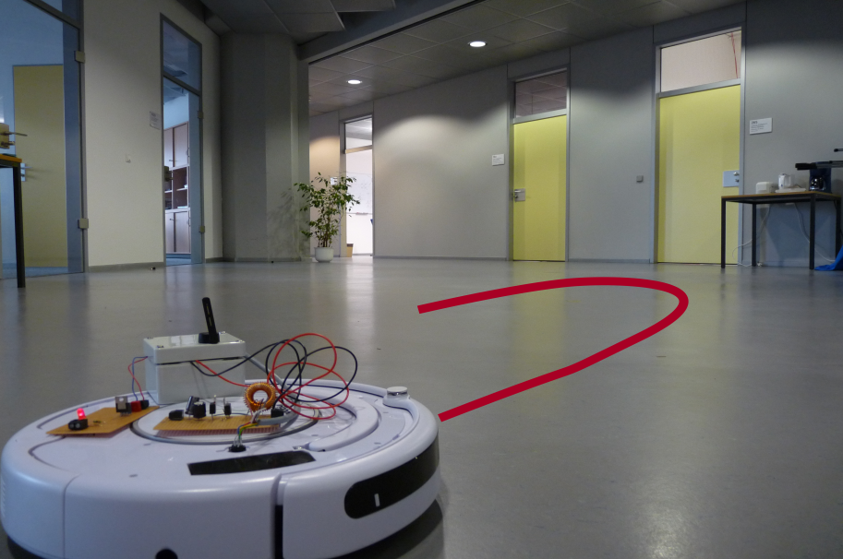
MichaelEClarke@flickr
One-Dimensional Agents
Two-Dimensional Agents

Slide 10
One-Dimensional Agents
MichaelEClarke
@flickr

Slide 11
One-Dimensional Agents
MichaelEClarke
@flickr
  no simultaneous movement

Slide 12
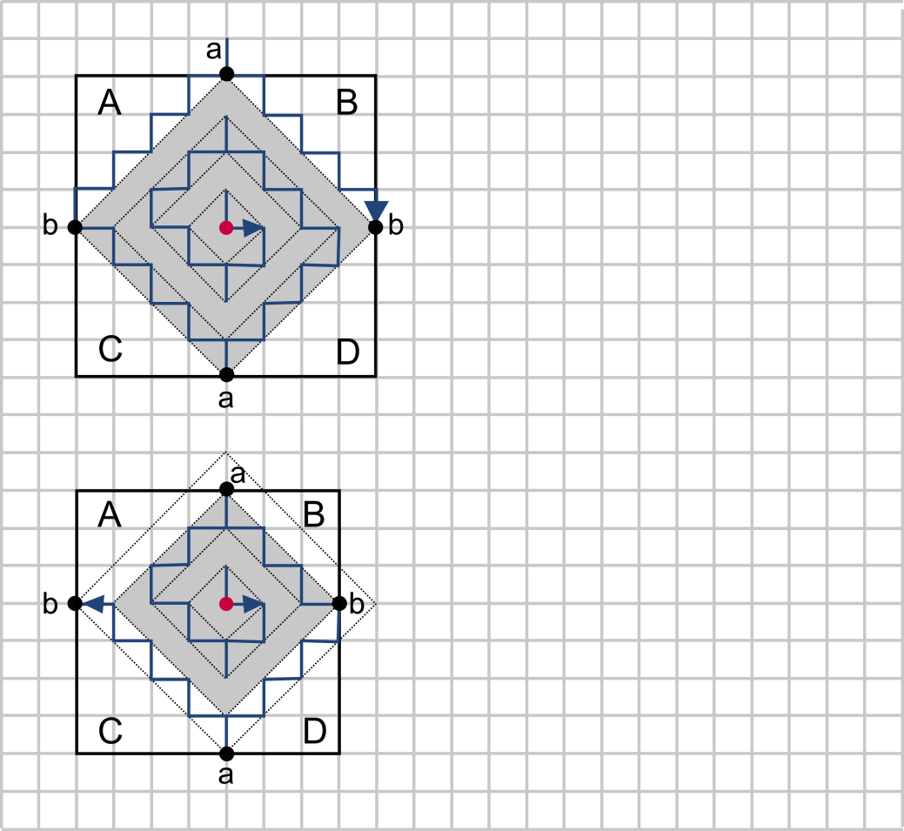
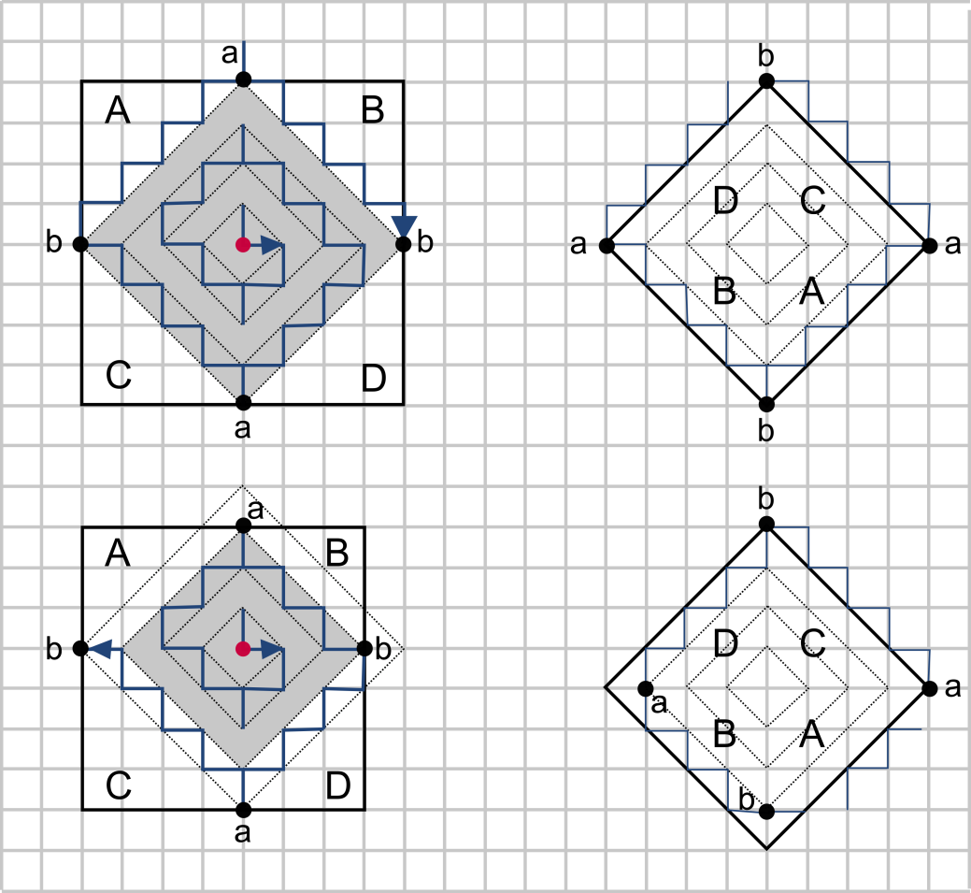
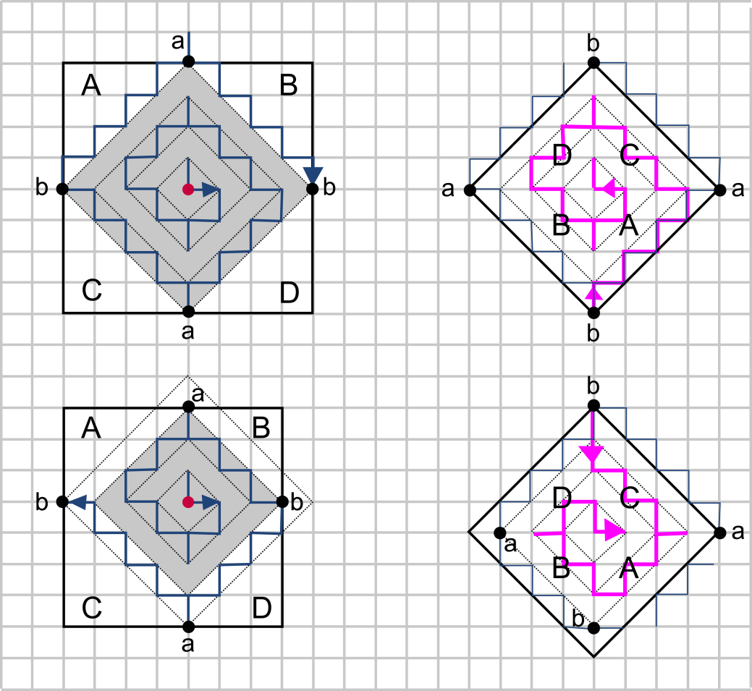

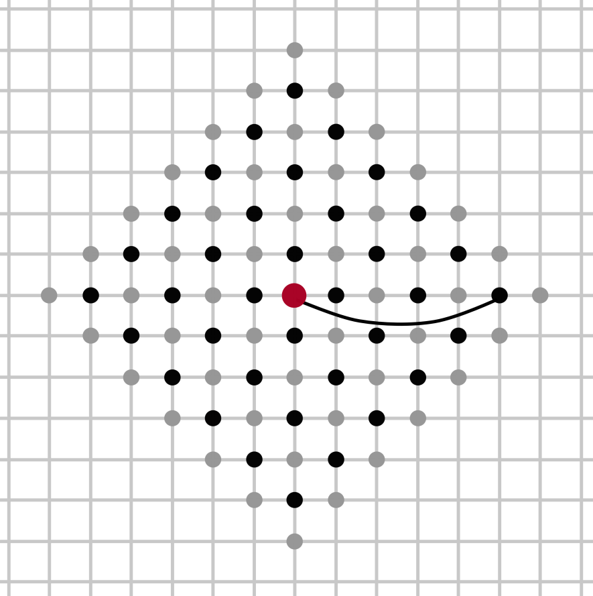
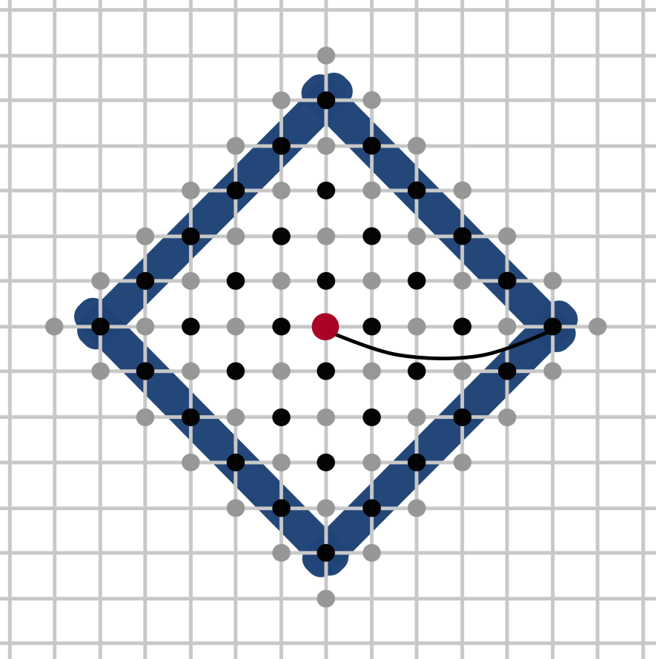
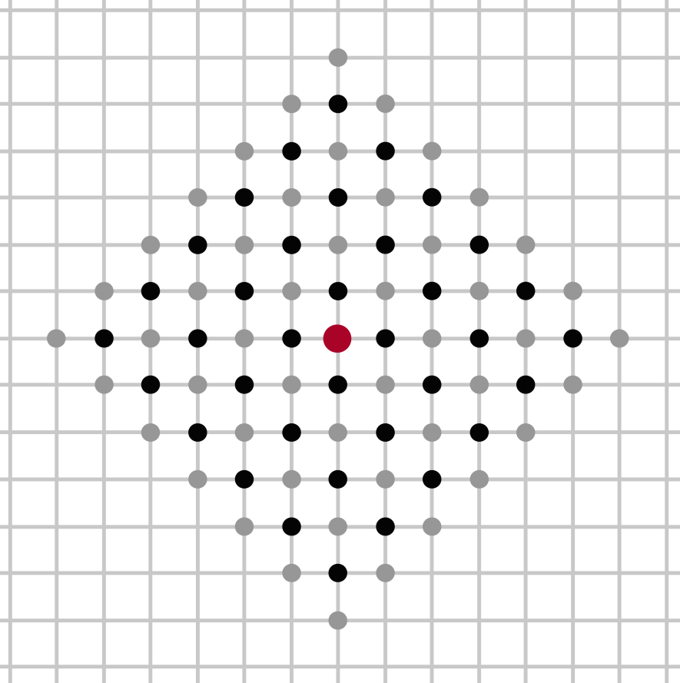
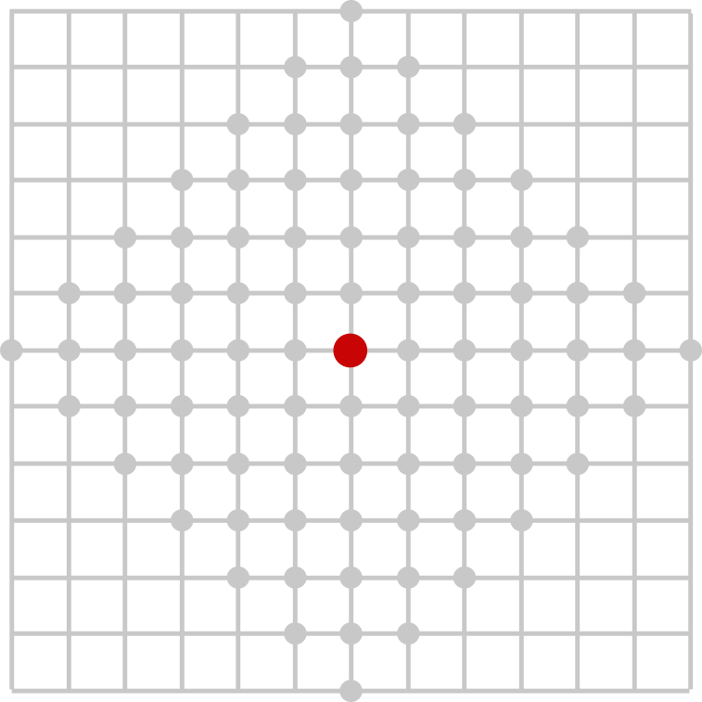
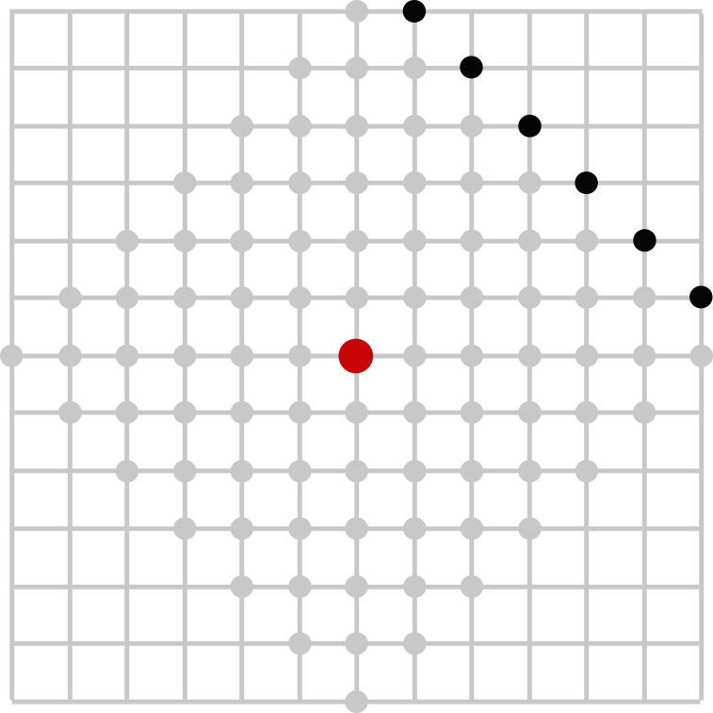

One-Dimensional Agents
closed curves of equal length l
any algorithm that finds an intersection in distance at most k needs at least
  2k² + 2k - 4 steps (k<n)
  2n² + 4zn + 2n - 2z² - 2z - 4 steps (n<k, k=n+z)
strategy uses at most
  2k² + 5k + 2 steps (k<n)
  2n² + 4zn + 7n - 2z² - 3z + 2 steps (n<k, k=n+z)
strategy is 13/4 search competitive
4k
k
MichaelEClarke
@flickr

Slide 13
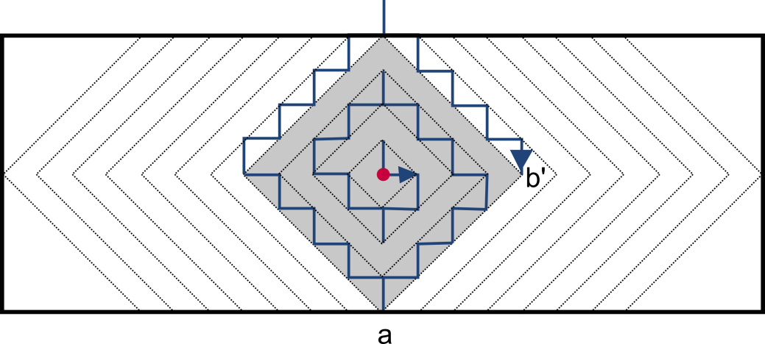
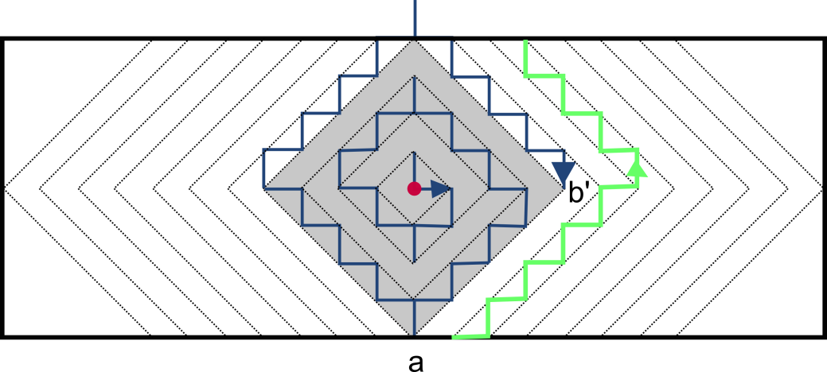
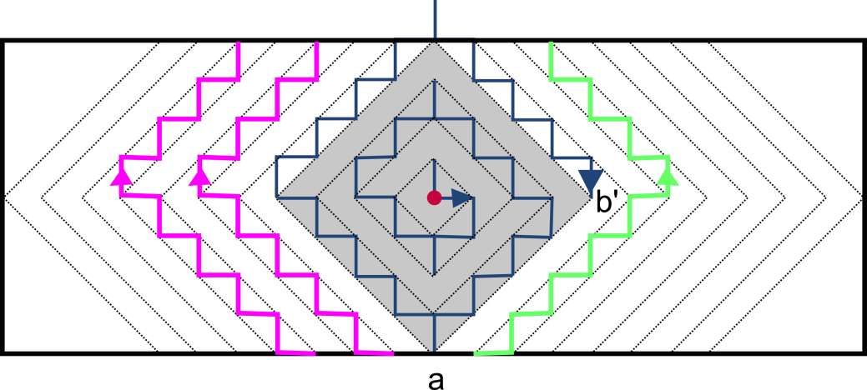
One-Dimensional Agents
closed curves of different length
strategy uses at most
  2k² + 5k + 2 steps (k≤n)
  6n² + 7n + 2^{j}(n+3) + 4nz‘ + 2j - 2 steps (n<k=n+z‘, 2^{j-1}<z‘≤2^{j})
  5mn + n² + 4zn + 4n + 3m - 2z² - 2z + 2 log(m-n) - 2 steps (k=m+z)
any algorithm that finds an intersection in distance at most k needs at least
  2k² + 2k - 4 steps (k≤n)
  2n² + 2n + z‘(4n+2) - 4 steps (n<k=n+z‘≤m)
  4mn - 2n² + 4zn - 2z² - 2z + 2m – 4 steps (k=m+z)
the strategy is 11/2 search competitive
MichaelEClarke
@flickr

Slide 14
One-Dimensional Agents
MichaelEClarke
@flickr
  simultaneous movement

Slide 15
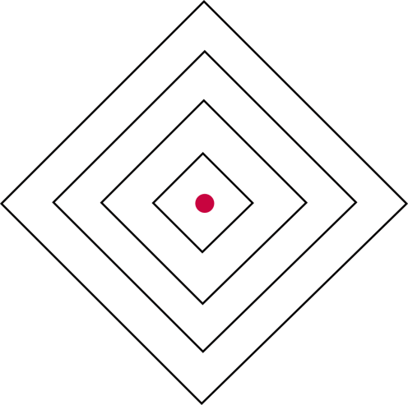
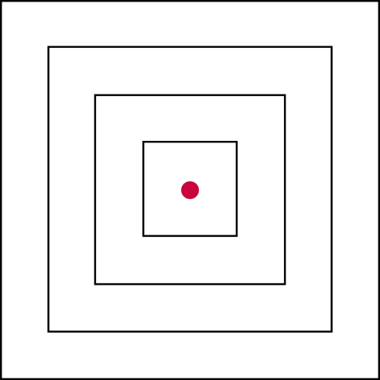
One-Dimensional Agents
agents move alternatingly
→ all points of equal distance to the start on a diamond
agents move simultaneously
→ all points of equal distance on a square
MichaelEClarke
@flickr

Slide 16
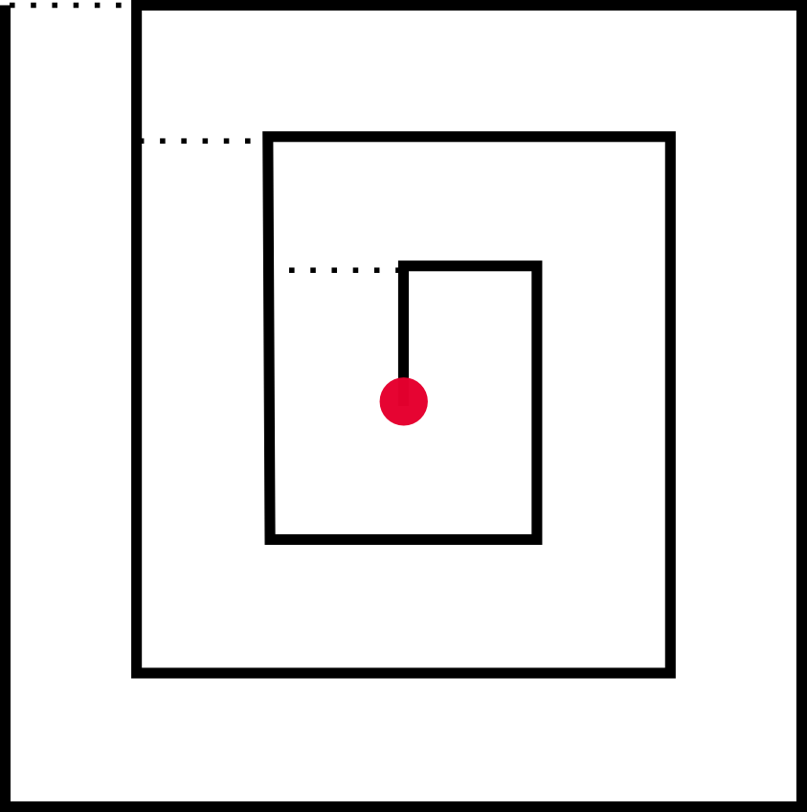
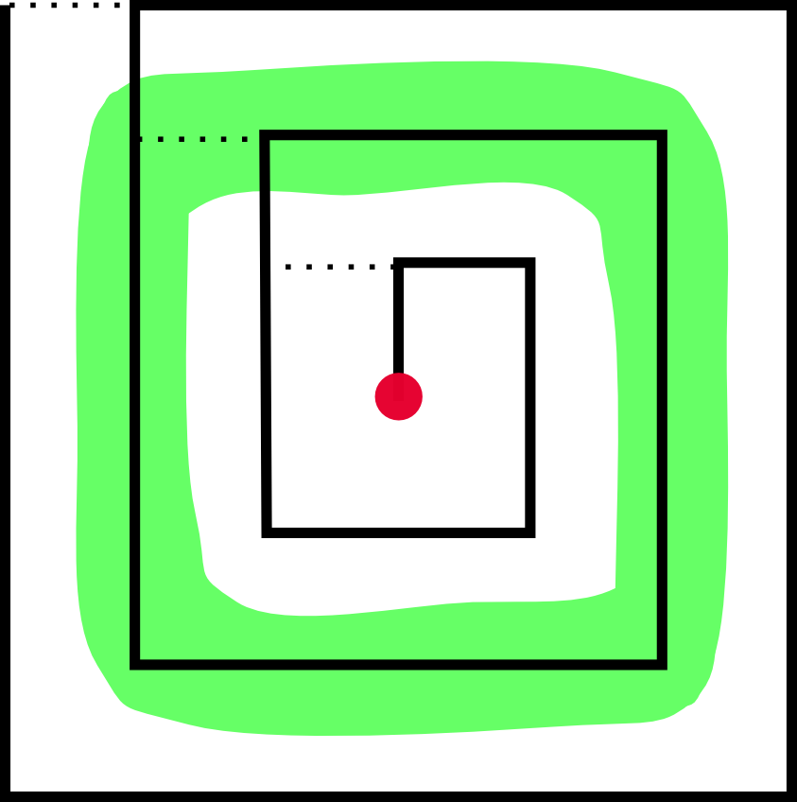
One-Dimensional Agents
two curves of equal length
an optimal strategy moves on a rectangular spiral-like search pattern:
  target at some unknown finite distance k
  if agent knows upper bound k‘
  does not visit points in distance k‘ + 1
  if agents does not know an upper bound:
    agent has to cover each layer of points of the same distance, before visiting a point of the next layer
  connection of two layers: 1 step
  ➔ squared spiral optimal
MichaelEClarke
@flickr

Slide 17
One-Dimensional Agents
Theorem:
Even if the agents are allowed to move simultaneously, there is an optimal strategy in which the agents move alternatingly.
MichaelEClarke
@flickr

Slide 18
Two-Dimensional Agents

Slide 19



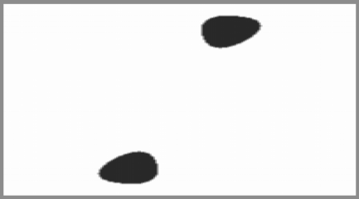


Two-Dimensional Agents
agent = disk of radius R
curves – circles of radius r
search space: torus
but: infinite number of rendezvous points.
set of rendezvous points: no more than 2 connected components (CCs)
goal: find a convex region of certain size (in CCs)
  inspect finite point set on grid
  or
  → move on Archimedean spiral
R
r

Slide 20
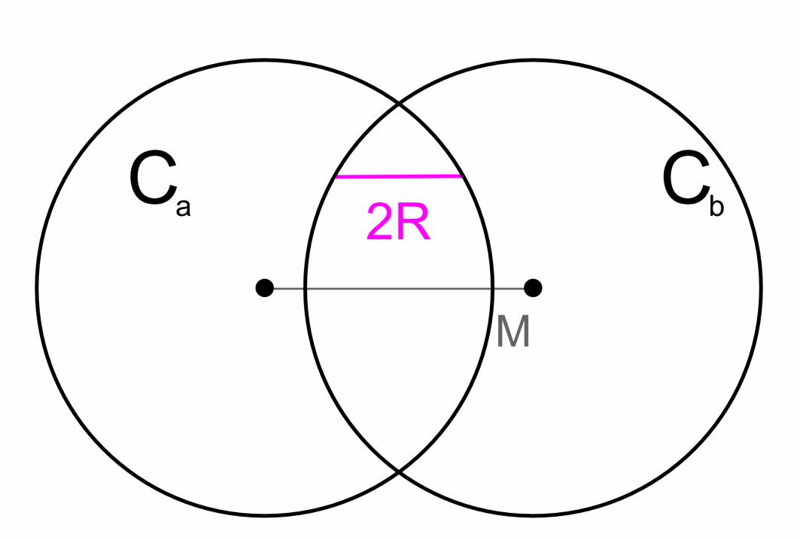
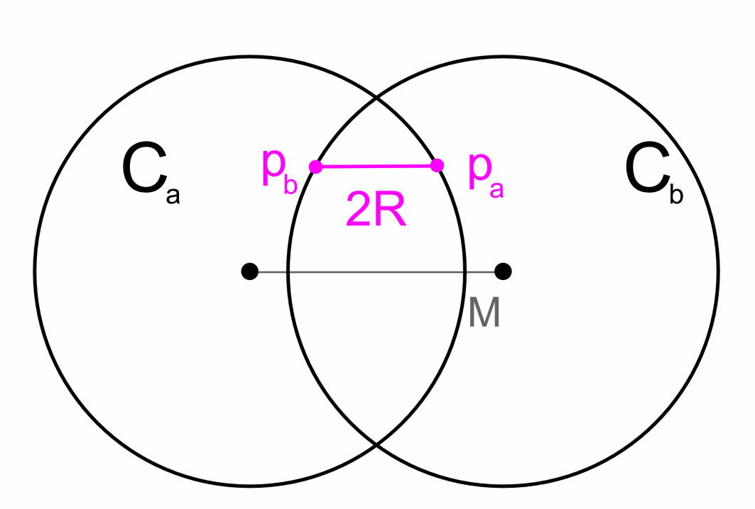
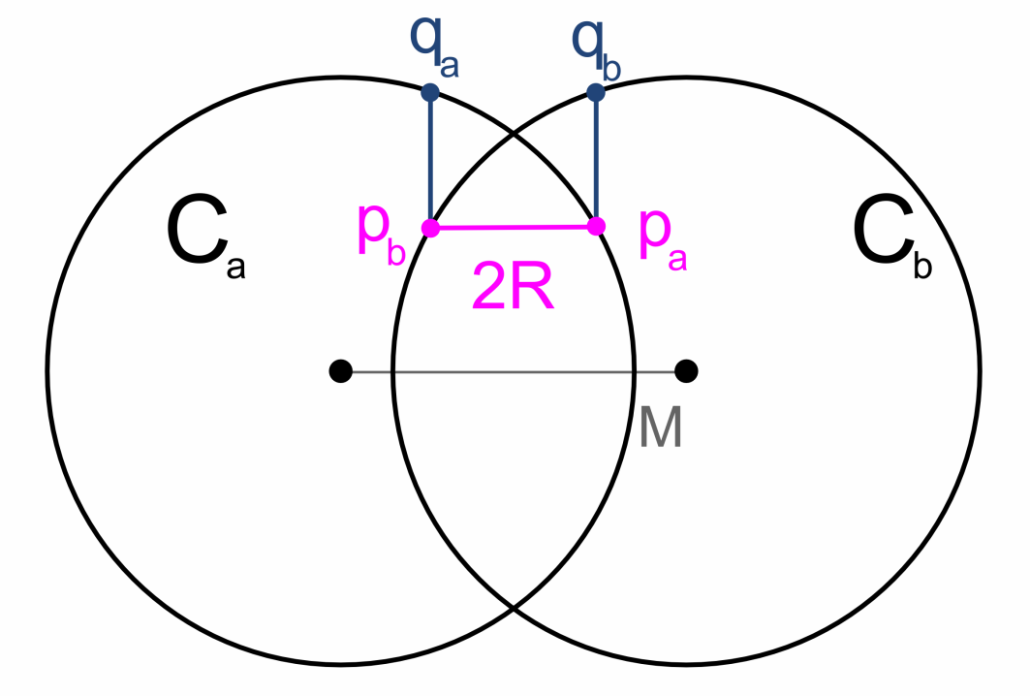
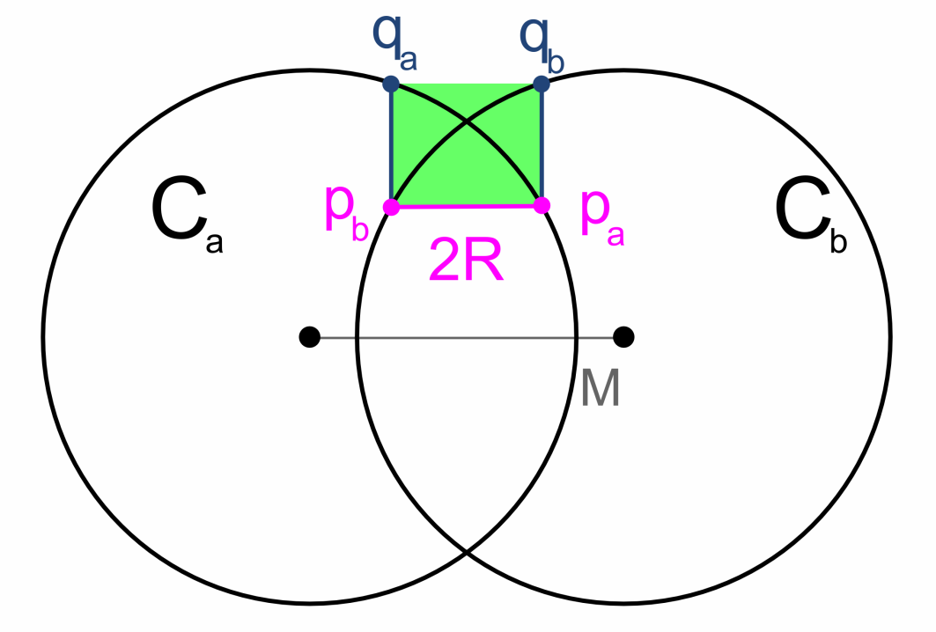
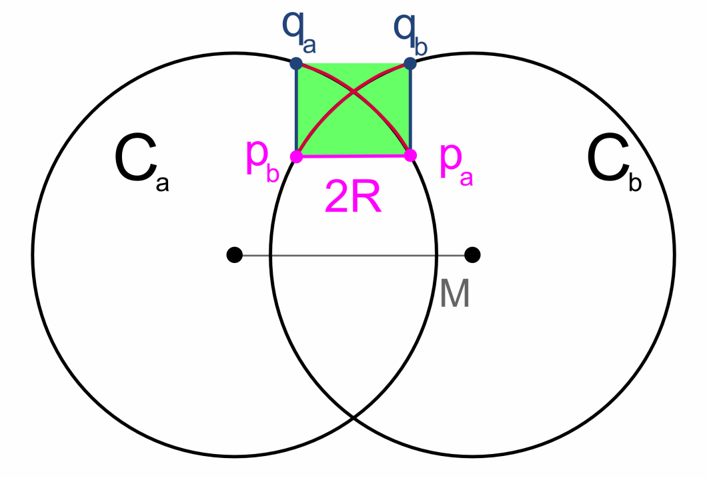
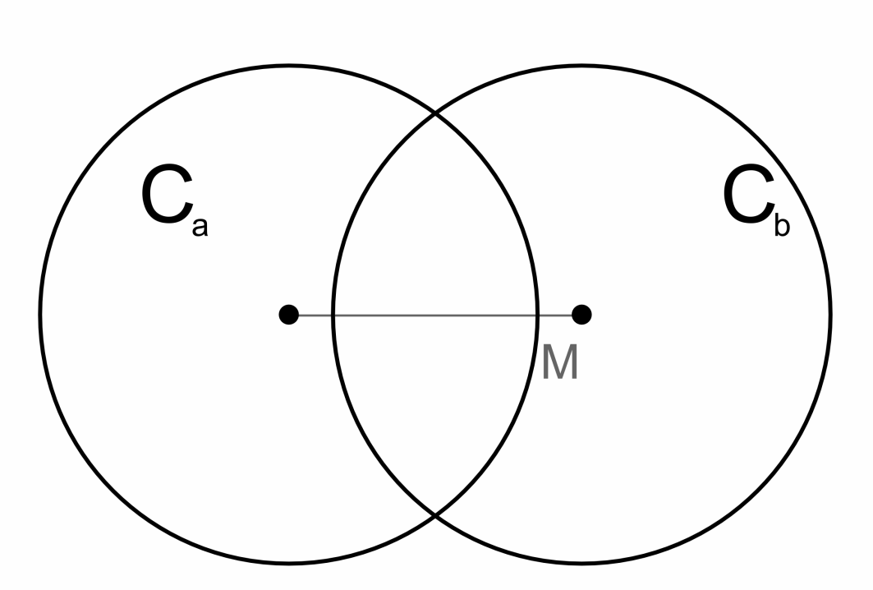
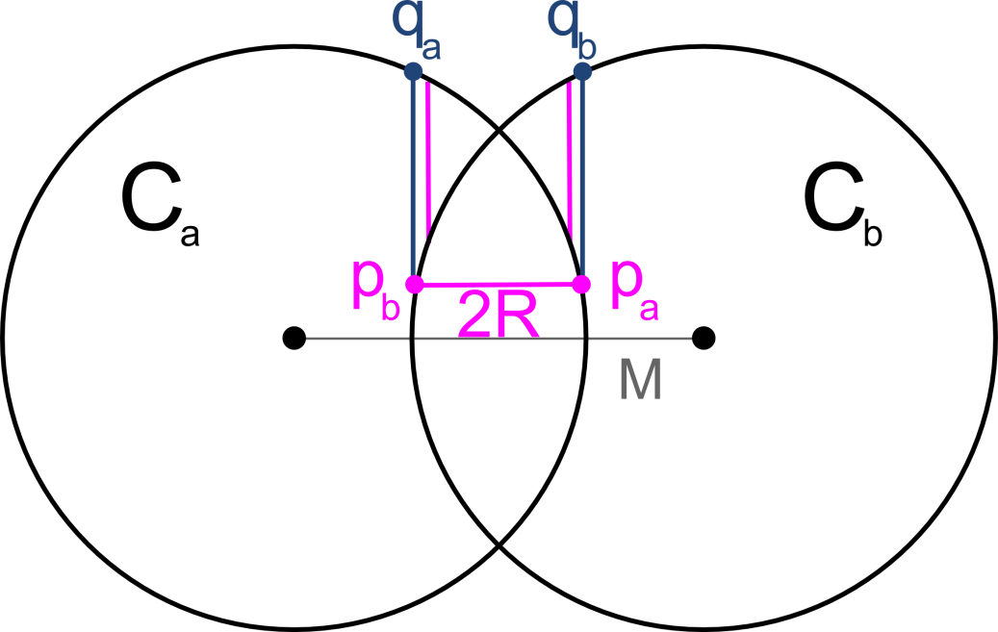
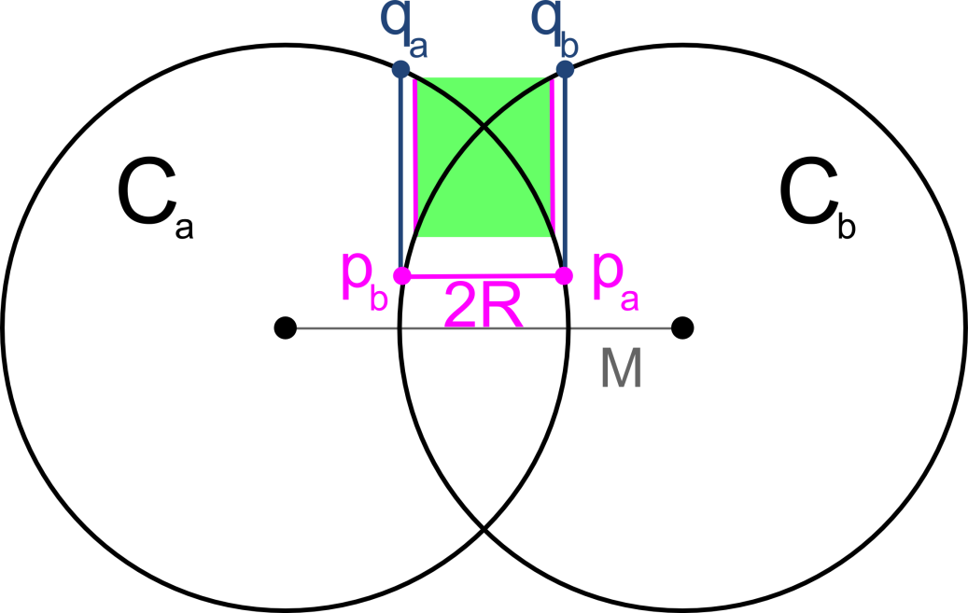
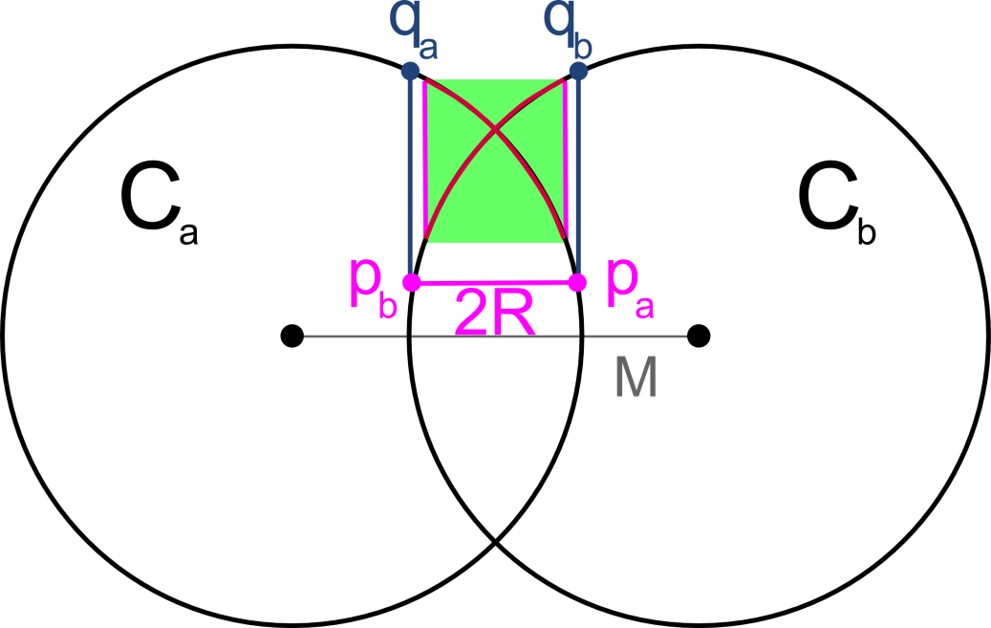
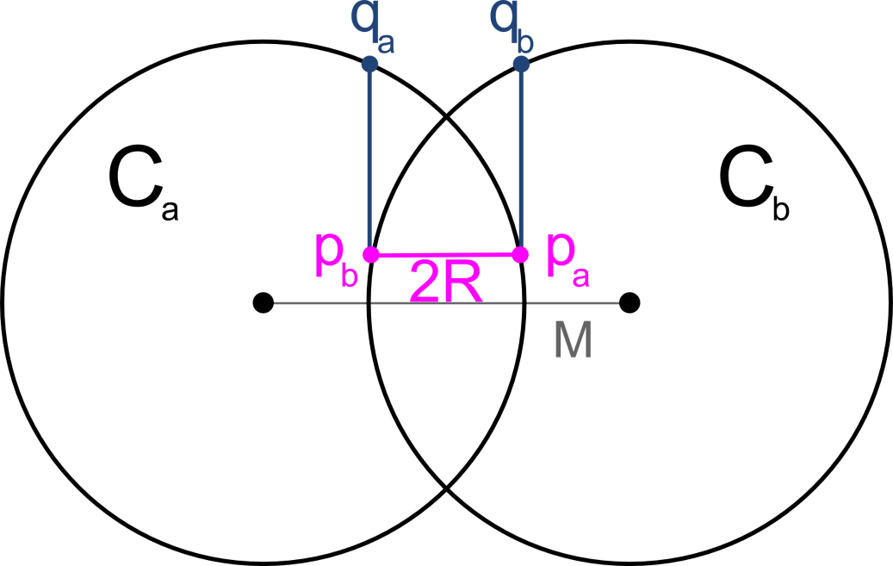
Two-Dimensional Agents
Case 1: |p_{a}q_{b}| ≤ 2R
Case 2: |p_{a}q_{b}| > 2R

Slide 21
Two-Dimensional Agents
In the search space there is a square of size at least 2R x 2R such that all points inside the square are rendezvous points.

Slide 22
Outlook

Slide 23
Outlook
 | infinite/infinite | infinite/finite | finite/finite
open/open
open/closed
closed/closed
Baeza-Yates et al.
variants of strategies presented today
today
Related geometric problems

Slide 24
Thank you.

Slide 29
Motivation – Finding Intersections
One-Dimensional Agents
  No simultaneous movement
  Simultaneous movement
Two-Dimensional Agents
Outlook
MichaelEClarke
@flickr

Slide 30
Motivation

Slide 31
Motivation
planning motions for mobile agents:
  motion primitives
  sensors
  communication
here: agents perform geometric primitives
  move to another agent
  move on ray between two other agents
  move on a circle
what can we achieve with this model?
intersection point of trajectories of two agents

